Slide 1
Building Scalable Applications with Foundatio
Blake Niemyjski

Slide 2
What is it?
Pluggable foundation blocks for building loosely coupled distributed apps
Caching
Queues
Locks
Messaging
Jobs
File Storage
Metrics
Logging

Slide 3

Why use it
Great development story
Separation of concerns
Loosely coupled
Abstracted interfaces
Pluggable implementations
Stateless
Dependency Injection Friendly
Open Source

Slide 4
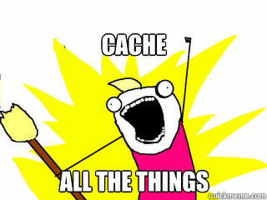
Caching
Strongly Typed
Cache expensive data
Cache frequently accessed data
It’s more than just a cache
Cache X Items
HybridCacheClients save the day
Serialization wins!

Slide 5

Queues
First In, First Out (FIFO)
Queue all the things
Work items
Sending mail

Slide 6

Locks
Distributed Locks
Ensure a resource is only accessed by one consumer
Used extensively by Jobs
Throttling locks

Slide 7

Messaging
Publish and Subscribe to messages
Encourages loosely coupled architecture
Enable real time applications
Small messages

Slide 8

Jobs
Run in process
Out of process
Scale independently
Web jobs

Slide 9

File Storage
Abstracted file storage
Implementations
In memory
Folder
Azure Blob
S3

Slide 10

Metrics
Instrumentation of your application gives you visibility into your app.

Slide 11

Logging
Abstracted fluent interface for logging
No lock in
Pluggable implementations
NLog
Log4net
xUnit

Slide 12
Summary
Use Foundatio to build awesome apps!
Twitter: @blaken
GitHub: https://github.com/exceptionless/Foundatio
NuGet: http://www.nuget.org/packages/Foundatio/

